Slide 1
Classification
(Introduction, Logistic Regression)

Slide 2

Classification- Introduction
Classification is a supervised learning technique that is used to identify the category of new observations on the basis of training data.
In Classification, a program learns from the given dataset or observations and then classifies new observation into a number of classes or groups.
Mathematically, classification analysis uses an algorithm to learn the mapping function from the input variables to the output variable (Y) i.e. Y = f(x) where Y has discrete values
Classification of vegetables and groceries

Slide 3
Types of Classification
Binary Classification
It is a type of classification problem in which the output variable has only binary values (True/False, 0/1, Yes/No)
Examples of Binary classification are classifying Email Spam Detection (spam/ham), Medical Testing (patient having disease or not), customer risk analysis (fraudulent/non-fraudulent)
Multi-Class Classification
It is a type of classification problem in which the output variable has more than two discrete values.
For example, risk evaluation of customers (low risk, medium risk, high risk), text classification into different categories (sports, politics, entertainment), etc.

Slide 4
Types of Classification (Contd…)
Multi-Label Classification
It is a type of multi-class classification in which the examples can be labelled with multiple categories.
For instance, in text classification a text may belong to Sports as well as politics category (Virat Kohli joined politics).

Slide 5
Why Regression models are not used for Classification ?
Classification models are not useful for regression because of following reasons:
Regression models give continuous values of output variable and does not give probabilistic values.
Linear Regression models are insensitive to imbalance data.
Example for Point 2:
Let’s say we create a perfectly balanced dataset , where it contains a list of customers and a label to determine if the customer had purchased or not.
In the dataset, there are 20 customers.
10 customers age between 10 to 19 who purchased, and 10 customers age between 20 to 29 who did not purchase.

Slide 6
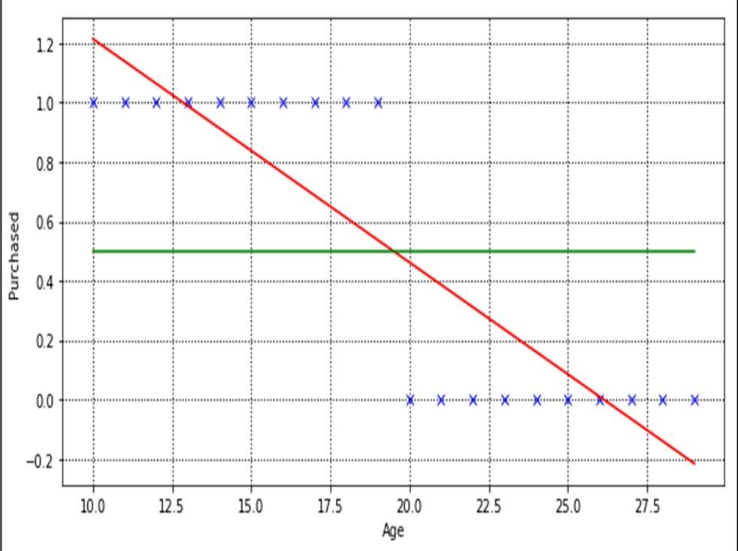
Why Regression models are not used for Classification ? (Contd….)
According to Linear regression model, the line of best fit is shown in Fig. 1(a).
To use this model for prediction is pretty straight forward.
Given any age, we are able to predict the value along the Y-axis. If Y is greater than
0.5 (above the green line), predict that this customer will make purchases otherwise will not make purchases.
Figure 1(a)

Slide 7
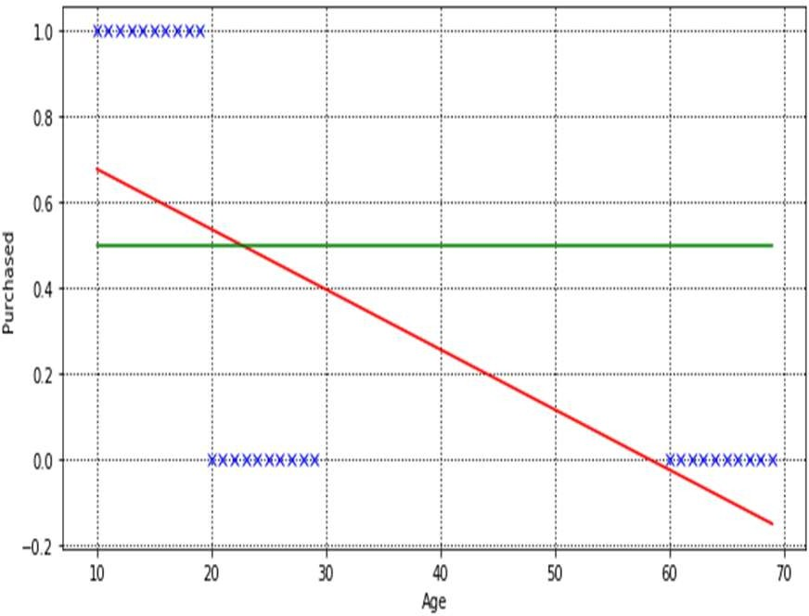
Why Regression models are not used for Classification ? (Contd….)
Let’s add 10 more customers age
between 60 to 70, and train our linear regression model, finding the best fit line.
Our linear regression model manages to fit a new line (Figure 1(b)), but if you look closer, some customers (age
20 to 22) outcome are predicted wrongly.
Figure 1(b)

Slide 8
Logistic Regression
Logistic regression is one of the most popular Machine Learning algorithms, which comes under the Supervised Learning technique.
It is used for predicting the categorical dependent variable using a given set of independent variables.
Logistic Regression is much similar to the Linear Regression except that how they are used. Linear Regression is used for solving Regression problems, whereas Logistic regression is used for solving the classification problems
Logistic regression uses the concept of predictive modeling as regression; therefore, it is called logistic regression

Slide 9
Logistic Regression-Hypothesis Function
The hypothesis function that maps the given values of the input variable to the output variable is a sigmoid (logistic) function given by:
1
𝑦^ = 𝑓 𝑥 =
_{1 + 𝑒}–(β₀+β₁x₁+β₂x₂+⋯…………..+β_{k}x_{k})
where, x₁, x₂, x₃…..x_{k} are k independent features on which the output variable depends and β₁, β₂, β₃…..β_{k} are coefficients of independent features
In other words, hypothesis function, is given by:
𝑦^ = 𝑓 𝑥 =
1
1 + 𝑒^{–z}
and z = 𝛽₀ + 𝛽₁𝑥₁ + 𝛽₂𝑥₂ + ⋯ … … … … . . +𝛽_{k}𝑥_{k}

Slide 10

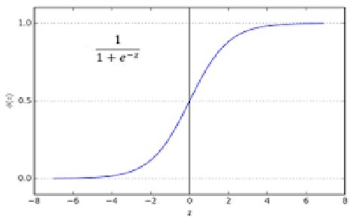
Hypothesis function- Characteristics
Hypothesis function is:
𝑦^ = 𝑓 𝑥 = ¹
1 + 𝑒^{–z}
and z = 𝛽₀ + 𝛽₁𝑥₁ + 𝛽₂𝑥₂ + ⋯ … … … … . . +𝛽_{k}𝑥_{k}
Therefore, The value of the logistic regression must be between 0 and 1, which cannot go beyond this limit.
So, it forms a curve like the "S" form.
If z=0;
^
1 1 1
1+e^{—z} 1+e^{—0} 1+1
If z=∞;
^
1 1 1
1+e^{—z} 1+e—∞ 1+0
If z=-∞;
^
1 1 1
1+e^{—z} 1+e∞ 1+∞

Slide 11



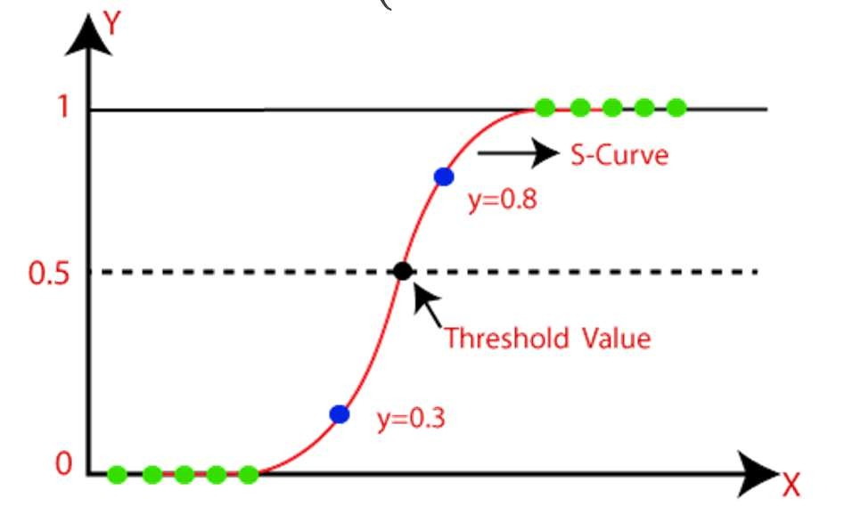

Interpretation of Hypothesis Function
The sigmoid (logistic) hypothesis function gives value between 0 and 1.
So, the output of sigmoid function is considered as the probability of label to be 1 given some value of input variables, i.e.,
^
^
^
1 2
₃….. _{k})
Therefore, if the probability is greater than or equal to 0.5, we assign label 1, else we assign label 0.

Slide 12


Decision Boundary
If
^
This is possible iff ; z
0 (because if z 0 then
𝒌 𝒌
1
1+e^{—z}
0
0.5)
i.e.,
If
𝟎 𝟏 𝟏 𝟐 𝟐
^
This is possible iff ; z
0 (because if z
0 then
𝒌 𝒌
1
1+e^{—z}
0
< 0.5)
i.e.,
𝟎 𝟏 𝟏 𝟐 𝟐

Slide 13
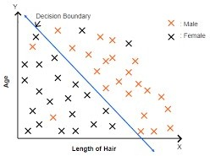

Decision Boundary Contd…
For example, in the figures shown below, depending upon the age (x₁) and length of hair(x₂) the person is classified as male (1) or female (0).
So, the hypothesis function will be:
1
𝑦^ = 𝑓 𝑥 =
_{1 + 𝑒}–(β₀+β₁x₁+β₂x₂)
Now, examples are labelled as male (1) if 𝛽₀ + 𝛽₁𝑥₁ + 𝛽₂𝑥₂ ≥ 0
i.e., all points above or on the line 𝛽₁𝑥₁ + 𝛽₂𝑥₂= -
𝛽₀
Now, examples are labelled as male (1) if 𝛽₀ + 𝛽₁𝑥₁ + 𝛽₂𝑥₂ < 0
i.e., all points below the line 𝛽₁𝑥₁ + 𝛽₂𝑥₂= - 𝛽₀

Slide 14
Decision Boundary Contd…
The decision boundary may be of any shape linear or non linear (depending upon the z function we choose for the sigmoid function).
The decision boundary is insensitive to balanced or imbalanced data and is characteristic of hypothesis function.
For example, for the purchase labeling problem discussed in slides 6 and 7, the logistic regression will classify correctly in both the cases (as shown in figures in the next slide).

Slide 15
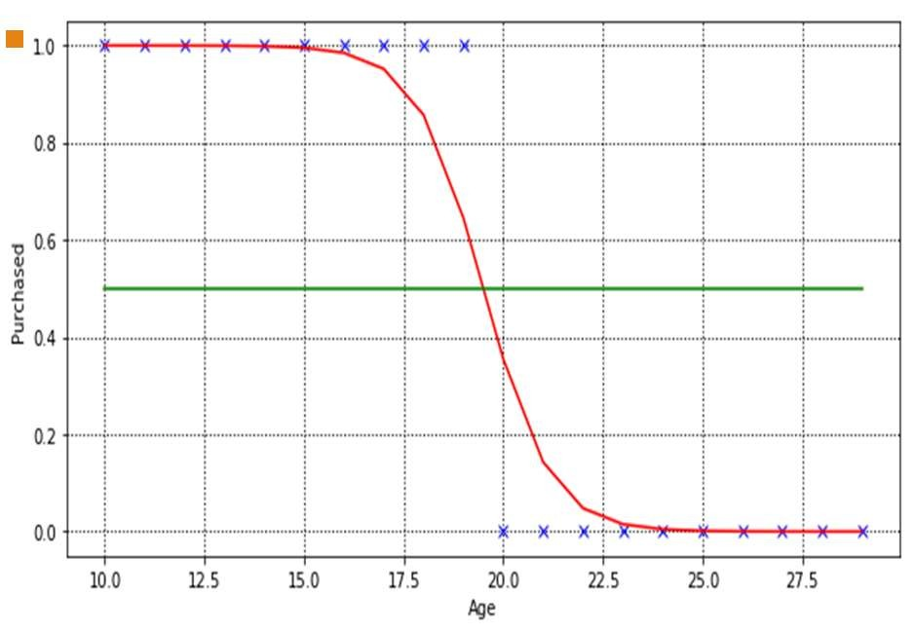
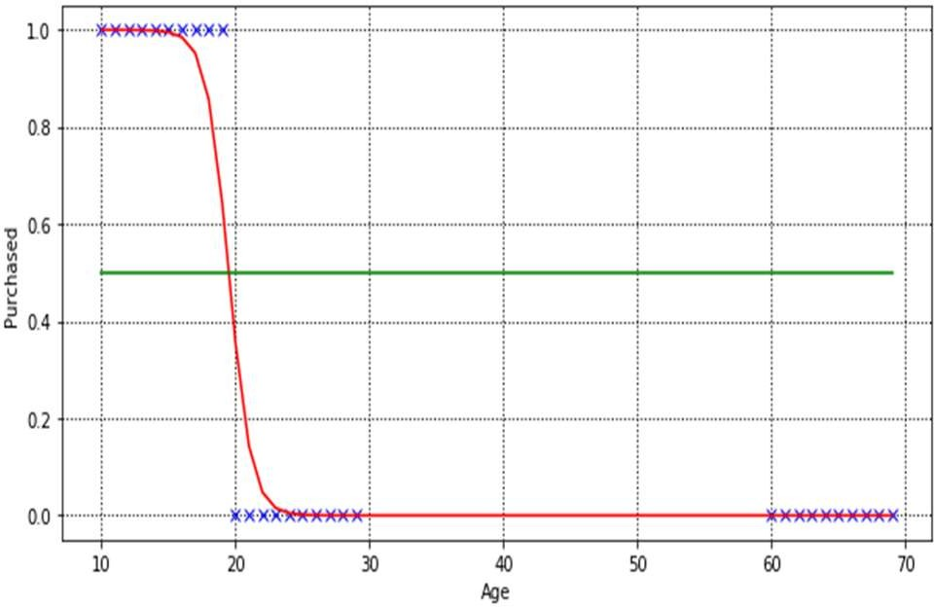
Decision Boundary Contd…
LOGISTIC REGRESSION MODEL FOR 20 CUSTOMERS (BALANCED DATA)
▪
LOGISTIC REGRESSION MODEL FOR 30 CUSTOMERS (IMBALANCED DATA)

Slide 16
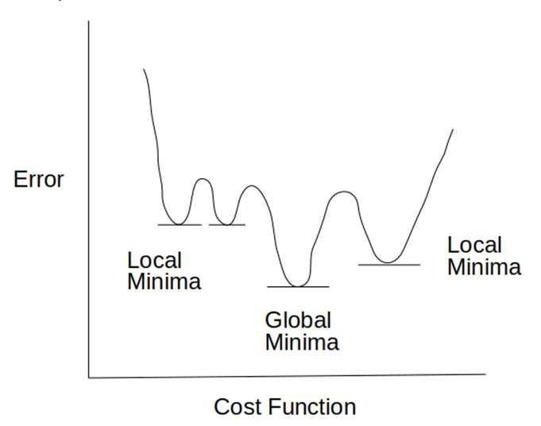
Logistic Regression- Cost Function
Logistic regression uses the concept of predictive modeling as regression i.e., it find the optimal value of coefficients (β’s) by minimizing the error/cost in labeling each training example.
But in case of logistic regression, we do not use mean square error (MSE) cost function given by the equation below:
n
This is due to the reason, if we use mean square error cost function with logistic function, it provides non-convex outcome which results in many local minima. (as shown below)
1
1
^{𝑦i −} _{1 + 𝑒}–(𝜷_{𝟎}+𝜷_{𝟏}𝒙_{𝒊𝟏}+𝜷_{𝟐}𝒙_{𝒊𝟐}+⋯…………..+𝜷_{𝒌}𝒙_{𝒊𝒌})
2
𝑀𝑆𝐸 = _{𝑛} Σ
i=1

Slide 17
Cost Function Contd……..
Thus, for logistic regression, we use maximum likelihood cost function (cross entropy function) which is computed as follows for every labeled example:
— log 𝑓 𝑥
𝑖𝑓 𝑦 = 1
𝑖𝑓 𝑦 = 0
𝐶𝑜𝑠𝑡 𝑜𝑟 𝐸𝑟𝑟𝑜𝑟 = {
— log 1 − 𝑓 𝑥
where, y is the actual value of the training example and f(x) gives the corresponding predicted value given by the sigmoid function.
The cross entropy cost function with logistic function gives convex curve with one local/global minima.
It adds zero cost if the actual and the predicted values are same (i.e., both zero or both one) else, it adds some positive cost proportional to the difference between actual and predicted value.
(shown in figure in next slide)

Slide 18
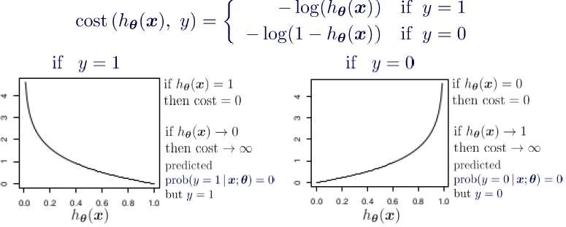
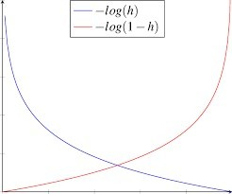
Cost Function Contd…..

Slide 19





Cost Function Contd…..
The two separate equations for y=1 and y=0 can be combined in the single equation as follows:
When y=1 ; and when y=0 ;
The total error for all the n training examples is thus computed as
This cost function is function of coefficients of input variables (β’s) whose optimal values are computed using optimization techniques like gradient descent optimization.

Slide 20
Gradient Descent Optimization for Logistic Regression
In logistic regression also, we use gradient descent optimization, for finding optimal values of β’s by minimizing the total cost over the training examples.
The gradient descent optimization considers gradient (slope/derivative) of the cost function.
First lets find out the partial derivative of the sigmoid function 𝑓 𝑥 =
1
w.r.t z
𝜕𝑓(𝑥) 𝜕 1 + 𝑒
_{= −1 ×} –1–1
–x
1+e^{—x}
–2
_{0 + 𝑒–x} 𝜕 −𝑥
𝜕𝑧
1 + 𝑒^{–x} = − 1 + 𝑒^{–x}
_{𝑒}–x
𝜕𝑧
𝜕𝑧
1 𝜕𝑥
¹ ⁻ (1 + 𝑒^{–x}) 𝜕𝑧
𝜕𝑥 1 1 + 𝑒^{–x} − 1 𝜕𝑥 1
⁼ (1 + 𝑒^{–x})² 𝜕𝑧 ⁼ (1 + 𝑒^{–x}) × (1 + 𝑒^{–x}) 𝜕𝑧 ⁼ (1 + 𝑒^{–x}) ×
𝜕𝑥
= 𝑓(𝑥)(1 − 𝑓 𝑥 ) _{𝜕𝑧}
Thus, partial derivative of sigmoid function f(x) w.r.t some variable z, is the product of f(x) and (1-f(x)) and derivative of power w.r.t z.

Slide 21







Gradient Descent Optimization for Logistic Regression (Contd….)
For logistic regression, cost function is given by:
n
1
= − ¹ ∑^{n} 𝑦 ×
1
ƒ x_{i}
× 𝑓 𝑥_{i} × (1 − 𝑓 𝑥_{i} × 𝑥_{ij} + 1 − 𝑦_{i} ×
1
n
i=1 i
𝐽 = − Σ 𝑦_{i}𝑙𝑜𝑔(𝑓 𝑥_{i} ) + 1 − 𝑦_{i} log(1 − 𝑓 𝑥_{i} )
× (0 − 𝑓(𝑥 )(1 − 𝑓 𝑥 ) × 𝑥 )
𝑛
1–ƒ x_{i}
i i ij
i=1
(Using the derivative of sigmoid function computed in previous slide and derivative of power 𝜷_{𝟎} + 𝜷_{𝟏}𝒙_{𝒊𝟏} + 𝜷_{𝟐}𝒙_{𝒊𝟐} + ⋯ … + 𝜷_{𝒌}𝒙_{𝒊𝒌} w.r.t
𝛽_{j} is the input variable values ).
Where f 𝑥
₌ 1
i _{1+e}—(𝜷_{𝟎}+𝜷_{𝟏}𝒙_{𝒊𝟏}+𝜷_{𝟐}𝒙_{𝒊𝟐}+⋯…………..+𝜷_{𝒌}𝒙_{𝒊𝒌})
Gradient of cost function w.r.t any j^{th} coefficient is given by:
n
𝜕𝐽
1 𝜕𝑦_{i}log(𝑓 𝑥_{i} )
𝜕 1 − 𝑦_{i} log(1 − 𝑓 𝑥_{i} )
+
𝜕𝛽_{j}
𝜕𝛽_{j}
= − Σ
𝜕𝛽_{j}
𝜕log(𝑓 𝑥_{i}) _{+ 1 − 𝑦}
𝜕𝛽_{j} ^{i}
𝑛
_{n} i=1
= − ¹ ∑^{n} 𝑦 × (1 − 𝑓 𝑥 × 𝑥 − 1 − 𝑦 × 𝑓(𝑥 ) × 𝑥
1
𝜕log(1 − 𝑓 𝑥_{i} )
𝜕𝛽_{j}
1 𝜕(1 − 𝑓 𝑥_{i} 1 − 𝑓 𝑥_{i} 𝜕𝛽_{j}
n
i=1 i i ij i i ij
= − Σ 𝑦_{i}
= − ¹ ∑^{n}
𝑥 𝑦 − 𝑓 𝑥 𝑦 𝑥 − 𝑓 𝑥 𝑥 + 𝑦 𝑓(𝑥 ) 𝑥
𝑛
i=1
n
i=1
ij i
i i ij i ij i i ij
n
n
1 𝜕𝑓 𝑥_{i}
𝑓 𝑥_{i} 𝜕𝛽_{j}
1
1
= − Σ 𝑦 ×
+ 1 − 𝑦 ×
= _{𝑛} Σ(𝑓 𝑥_{i} − 𝑦_{i}) × 𝑥_{ij}
i=1
𝑛
i
i
i=1

Slide 22
Gradient Descent Optimization for Logistic Regression (Contd….)
Thus derivative of cost function w.r.t to 𝛽_{j} is same as in case of linear regression.
The only difference is that in case of linear regression the hypothesis function is linear function of input variables whereas in logistic regression the hypothesis function is a sigmoid function of input variables.
The gradient descent optimization for Logistic Regression is summarized as below:
1. Initialize 𝛽₀ =0 , 𝛽₁ = 0, 𝛽₂ = 0,…………………………… 𝛽_{k} = 0
2. Update parameters until convergence or for fixed number of iterations using following equation:
n
𝛽_{j} = 𝛽_{j} − _{𝑛} Σ
i=1
𝛼 1
— 𝑦_{i} × 𝑥_{ij}
_{1 + 𝑒}– 𝜷_{𝟎}+𝜷_{𝟏}𝒙_{𝒊𝟏}+𝜷_{𝟐}𝒙_{𝒊𝟐}+⋯…………..+𝜷_{𝒌}𝒙_{𝒊𝒌}
For j=0,1,2,3……………..k
Where x_{i0}=1 and k are the total number of iterations

Slide 23
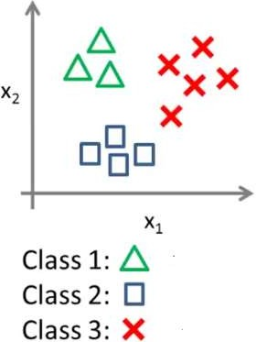
Logistic Regression for Multi-Class Classification
We will use a strategy called one-vs.-all (one- vs.-rest) classification, where we train a binary classifier for each distinct class and choose the class that has the largest value returned by the sigmoid function.
For instance, consider a classification problem, in which there are two input variables on the basis of which the examples are classified into three classes (marked as triangles, crosses, and squares in the figure)

Slide 24
Logistic Regression for Multi-Class Classification (Contd…..)
For each binary classifier that we train, we will need to relabel the data such that the outputs for our class of interest is set to 1 and all other labels are set to 0.
As an example, we have 3 groups A (0), B (1), and C (2) — we must make three binary classifiers:
A set to 1, B and C set to 0
B set to 1, A and C set to 0
C set to 1, A and B set to 0
After training, choose the class that has the largest value returned by the sigmoid function for each test case (as shown in figure)
Each binary classifier will give probability of ith label given the input feature values and choose that label for which probability is maximum.
_{𝑓}i
𝑥 = 𝑃(𝑦 = 𝑖|𝑥₁𝑥₂)
𝑖 = argmax 𝑓^{i} 𝑥
i

Slide 25
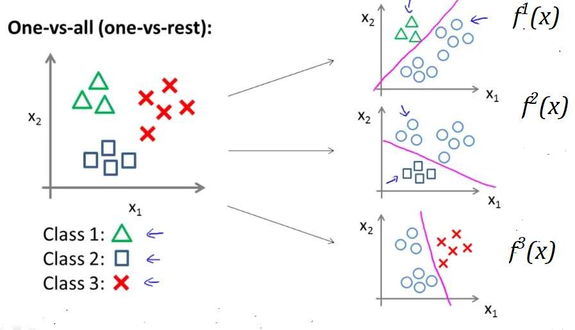
Logistic Regression for Multi-Class Classification (Contd…..)

Slide 26
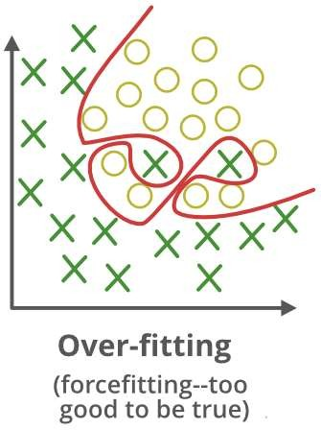
Regularization for Logistic Regression
Overfitting is also a problem of classification models, as we may fit a very complex decision boundary (lot of curves and angles) that considers each training examples but does not generalize well.
The problem of overfitting can be handled using regularization that shrinks the coefficients of input variables thereby smoothen the decision boundary to generalize well.

